Slide 2

Unit 3: Creating a Database Application

Slide 3
Lesson Objectives
After completing this lesson, you should be able to:
Explain App Builder concepts
Describe the types of applications you can build using Application Express
List the components of a database application
Create a database application based on existing tables
Create a database application from a file
Create a mobile web application
Notes:
This lesson introduces you to App Builder. First, you understand some of the basic concepts of App Builder. You understand the components of a database application. You learn how to quickly create an application from scratch and from a file

Slide 4

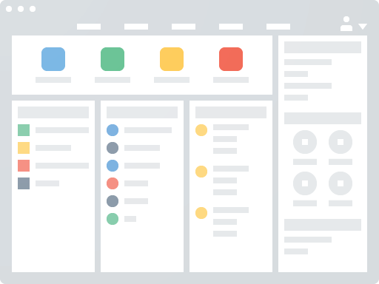



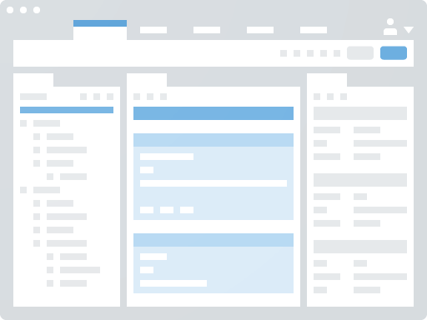
Understanding App Builder Concepts
Application Express Application
Application Page
Application User Interface
Session State
Page Processing and Page Rendering
Application URL Syntax
Notes:
An application is an HTML interface that exists on top of database objects such as tables or procedures. You use App Builder to build the pages that make up an Oracle Application Express application. Before using App Builder, you need to understand some basic concepts about Application Express applications, viewing rendered application pages, managing session state, and understanding URL.
Application Express Application An application is an HTML interface that exists on top of database objects such as tables or procedures. You (Application Developer) use App Builder to build the pages that make up an Oracle Application Express application.
Application Page A page is the basic building block of an application. Every application consists of one or multiple pages. Each page can have buttons and fields (called items) which are grouped into containers called regions. Pages can include application logic (or processes). You can branch from one page to the next using conditional navigation; perform calculations (called computations); perform validations (such as edit checks); and display reports, calendars, and charts. You can view and edit a page in Page Designer. Page Designer is a full featured Integrated Development Environment (IDE) designed to maximize developer productivity in maintaining application pages. The Application Express engine dynamically renders and processes pages based on data stored in database tables. To view a rendered version of your application, you run or submit it to the Application Express engine. As you create new pages, you can run them individually, or run an entire application. Application User Interface App Builder supports multiple user interfaces within a single application. You can choose to build an application for the desktop, for a mobile device, or for both. Each user interface defined for an application has its own theme, login page, home page, and global page. When you create a page within an application, you must specify which user interface is associated with that page. The user interface you select determines the options that display when creating pages and regions. For example, only desktop pages support maps, data loading, and interactive reports. Similarly, on mobile pages the most common construct is a list and form, instead of report and form. Applications built with the default desktop theme, Universal Theme, are responsive and can readily be run on any device including tablets and smartphones. Building mobile specific pages is only recommended when end users will be performing extensive data entry from a mobile device. Because mobile applications are designed to run specifically on smartphone devices, they are built with extremely minimal, semantic HTML that is optimized for mobile connections. Mobile applications developed with Oracle Application Express are browser-based applications that run inside the browser on the mobile device. Therefore, these applications must have a connection in order to communicate with the Oracle Database and cannot operate in a disconnected environment. Session State A session is a logical construct that establishes persistence (or stateful behavior) across page views. Each session is assigned a unique identifier. The Application Express engine uses this identifier (or session ID) to store and retrieve an application's working set of data (or session state) before and after each page view. Because sessions are entirely independent of one another, any number of sessions can exist in the database at the same time. A user can also run multiple instances of an application simultaneously in different browser programs. Sessions are logically and physically distinct from Oracle database sessions used to service page requests. A user runs an application in a single Oracle Application Express session from sign in to sign out with a typical duration measured in minutes or hours. Each page requested during that session results in the Application Express engine creating or reusing an Oracle database session to access database resources. Often these database sessions last just a fraction of a second. Page Processing and Page Rendering When you create an application in Application Builder, you link pages together using tabs, navigation menus, buttons, or hypertext links. Each page can have buttons and items and can include application logic. You can branch from one page to the next using conditional navigation, perform calculations and validations, and display reports, calendars, and charts. You can generate reports, charts, and forms using built-in wizards, static HTML, or deliver more custom rendering with PL/SQL programming. The Application Express engine dynamically renders and processes pages based on data stored in Oracle database tables. To view a rendered version of your application, you request it from the Application Express engine with a URL. When you run an application, the Application Express engine relies on two processes: Show Page is the page rendering process. It assembles all the page attributes (including regions, items, and buttons) into a viewable HTML page.
Accept Page performs page processing. It performs any computations, validations, processes, and branching.
When you request a page using a URL, the engine is running Show Page. When you submit a page, the Application Express engine is running Accept Page or performing page processing during which it saves the submitted values in the session cache and then performs any computations, validations, or processes. Application URL Syntax When you run a page, the URL that displays in your browser indicates the location of Oracle Application Express and identifies the address of Oracle Application Express, the application ID, page number, and session ID. For example:
http://apex.somewhere.com/pls/apex/f?p=4952:1:220883407765693447 This example indicates:
http: is the scheme.
apex.somewhere.com is the domain name of the server. It can also include a port number or an IP address.
pls is the indicator to use the mod_plsql cartridge (if applicable)
apex is the Database Access Descriptor (DAD) name. The DAD describes how HTTP Server connects to the database server so that it can fulfill an HTTP request. The default value is apex.
f?p= is a prefix used by Oracle Application Express to route the request to the correct engine process.
4952 is the ID of the application being called. The application ID is a unique number that identifies each application.
1 is the number of the page within the application.
220883407765693447 is the session number. When you run an application, the Application Express engine generates a session number that serves as a key to the user's session state.
To learn more about Application URL Syntax, see App Builder Concepts chapter in the Application Express App Builder User's Guide.

Slide 5
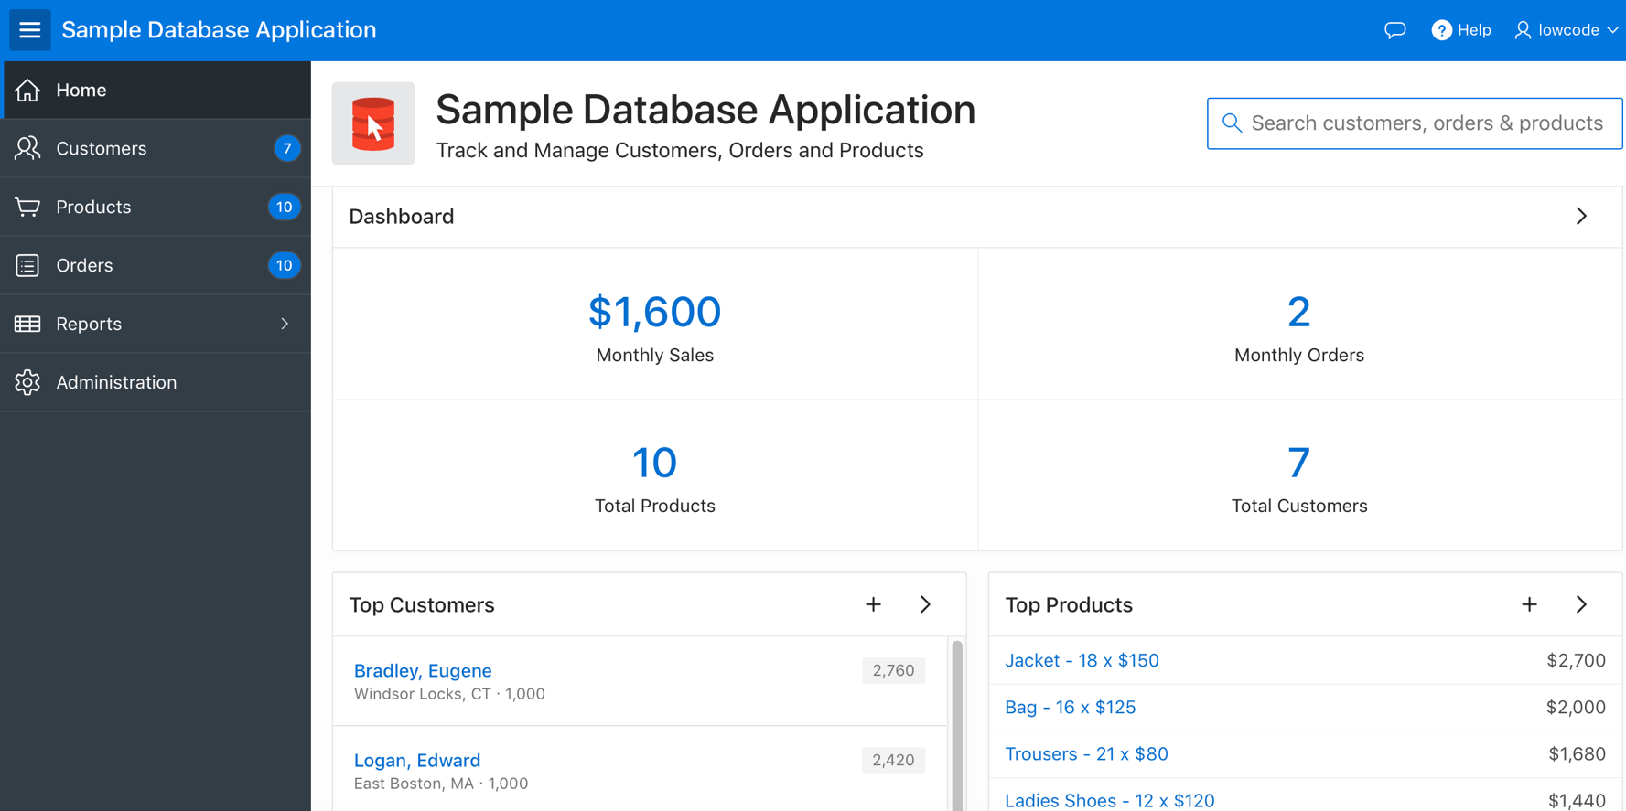
Understanding Database Web Applications
Notes:
The slide shows the Sample Database Application home page.
A database application is a collection of pages linked together using navigation menus, tabs, buttons, or hypertext links. Application pages share a common session state and authentication. To create a database application, an application developer runs wizards to declaratively assemble pages and navigation. Individual pages are organized using containers called regions. Regions can contain text, custom PL/SQL, reports, charts, maps, calendars, web service content, or forms. Forms are made up of fields (called items) which can be selected from the multitude of built-in types (such as text fields, text areas, radio groups, select lists, check boxes, date pickers, and popup list of values). Developers can also create their own custom item types using plug-ins. Session state (or application context) is transparently managed and the user interface presentation is separated from the application logic enabling developers to manage the look and feel of an application by simply selecting a different theme. Database applications enable developers to have full control over all aspects of the development process and final application functionality. With database applications, developers can directly leverage their SQL and PL/SQL programming skills. Database applications use declarative controls for developing, enhancing, and maintaining applications. They also support full user interface customization through the use of templates and themes. Using App Builder you can create two different types of applications: Database applications and Websheet applications. This course material covers Database applications.

Slide 6
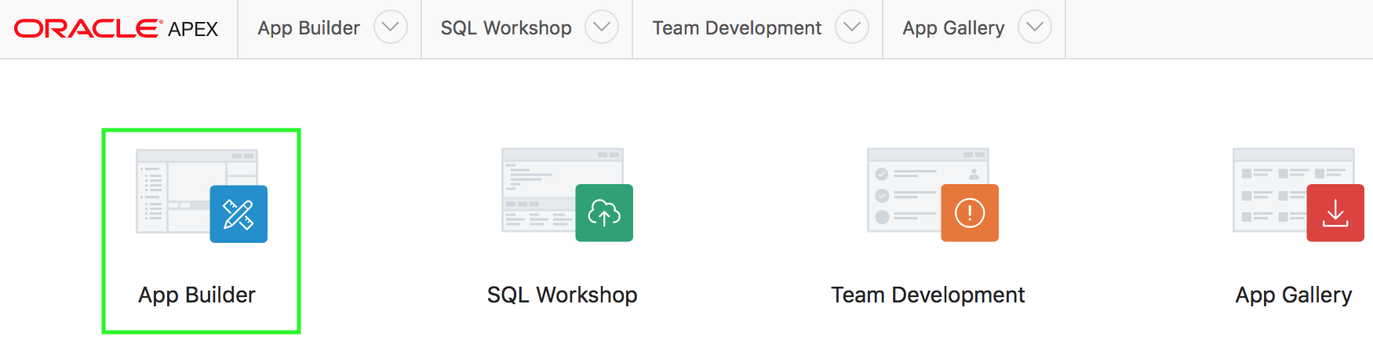
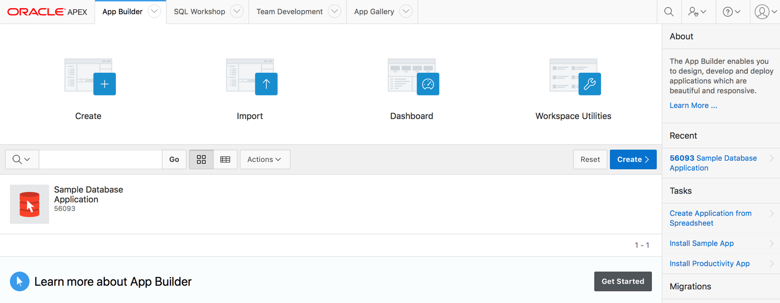
App Builder Home Page
Notes:
After logging in to your Workspace, on the Workspace home page, click App Builder. The App Builder home page displays all installed applications in the current Oracle APEX instance.
In the slide, the App Builder home page displays the installed application – Sample Database Application.
You use the App Builder home page to:
Select an application to edit
Create new applications
Import previously exported applications,
View the Dashboard
Access workspace
You can customize the appearance of the App Builder home page using the navigation bar in the center of the page. Once you select an application to edit on the App Builder home page, the Application home page appears.

Slide 7
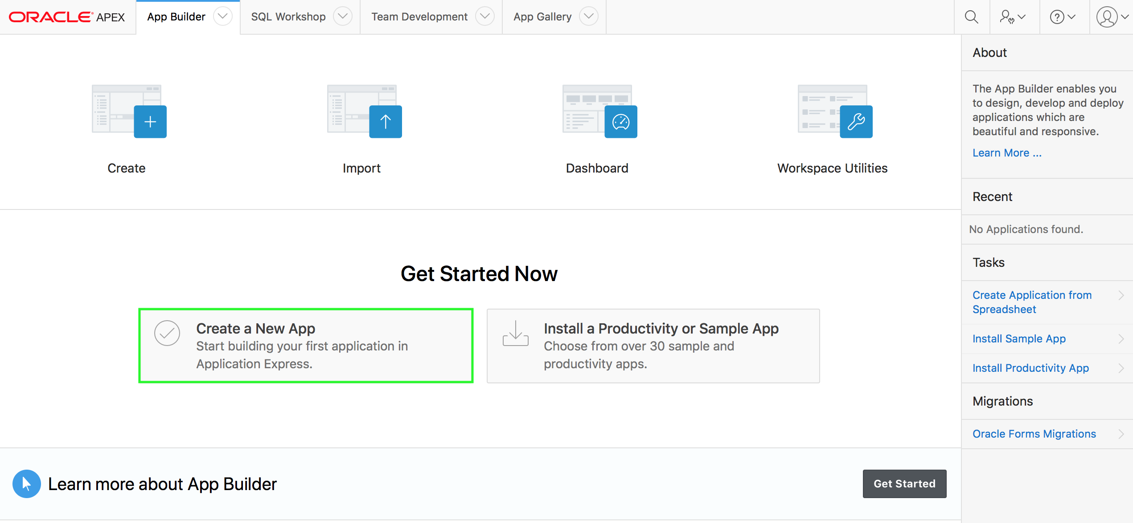
Creating a Database Application
Notes:
The slide shows the App Builder page when you log in to a new workspace and navigate to App Builder for the first time. In a new workspace, the bottom of the App Builder page displays two additional regions:
Click Create a New App to access the Create Application Wizard and create a new application.
Click Install a Productivity or Sample App to access the App Gallery and install a productivity or a sample application.
Once you create an application or install a packaged application, these regions no longer appear. You already learned how to install a packaged application. In this lesson, you learn how to use the Create Application Wizard to create a new application.

Slide 8
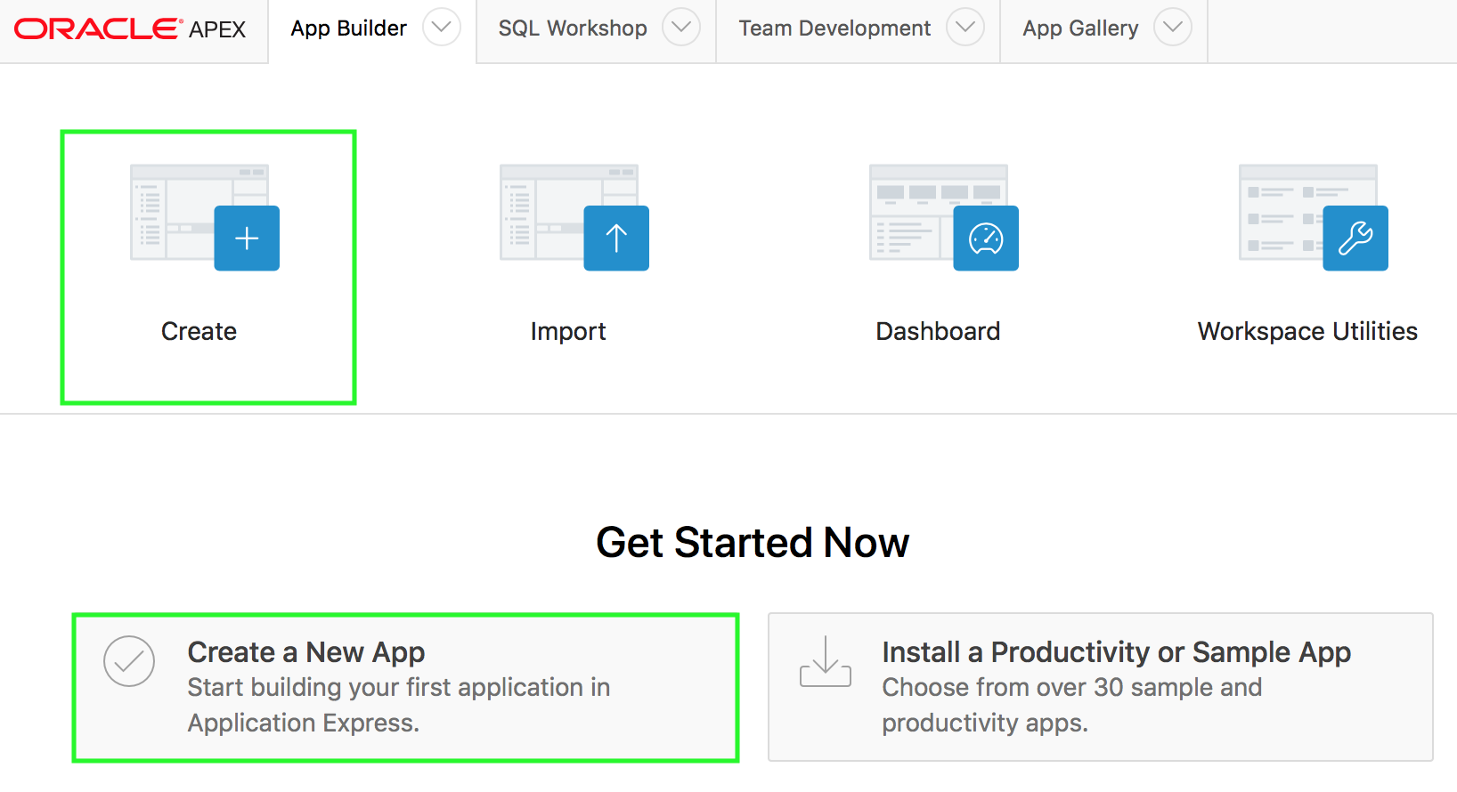
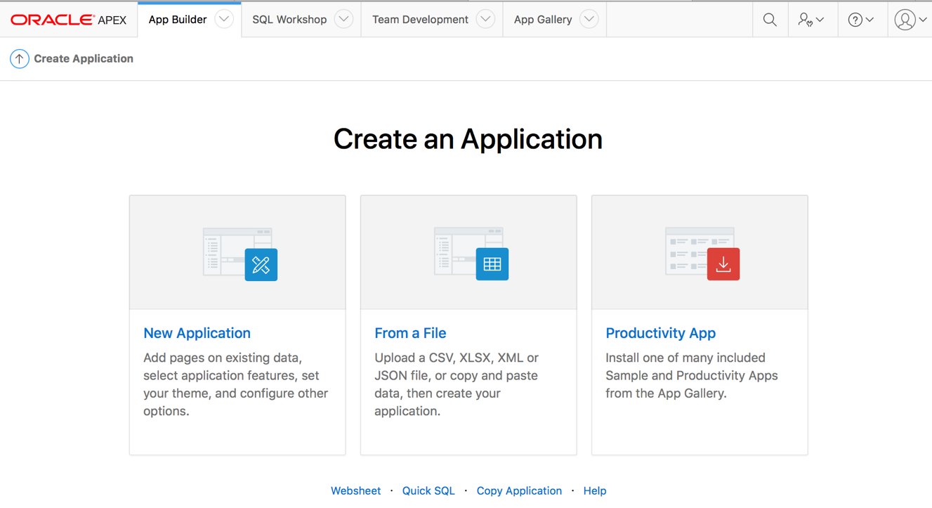
Using the Create Application Wizard
1
2
Notes:
The Create Application Wizard enables developers to design and quickly create basic Oracle Application Express applications. By using the Create Application Wizard, you can create a complete application containing multiple pages including a variety of different reports and forms. After you create an application using this wizard, you can modify pages and also add additional pages. You can use the Create Application Wizard to create an application with just a blank page or a complete application containing multiple pages.
When you run the Create Application Wizard, the wizard prompts you to choose the type of application you want to create. Options include:
New Application. Create a fully functional database application based on tables you select or by providing a valid SQL. You can add pages that include various components including calendars, cards, charts, dashboards, forms, interactive grids, master detail or editable grids, and reports. Add application-level features such as an Application About page, role-based user authentication, end user activity reports, configuration options to enable or disable specific functionality, a feedback mechanism to gather end users comment, and a Customize button to enable end users to choose their own theme style
From a File. Upload a CSV, XLSX, XML, or JSON file, or copy and paste data and then create your application.
Productivity App. Links to the App Gallery. The App Gallery include a set of business productivity and sample applications which can be installed with just a few clicks. Productivity apps are fully developed point-solutions designed to provide real functionality, such as project management, surveys, shared calendars, and tracking applications. Productivity applications can be installed, run and removed. By default they are 'locked' and are fully supported. Once unlocked, the application is no longer supported but it can be updated to meet specific requirements. Sample apps are not a complete applications but instead contains code snippets or sample code. Sample applications are available for installation in a workspace and are editable by default.
Websheet. Websheet applications enable users to build data centric applications without any SQL programming knowledge. Websheet applications are simplified applications that support pages, data grids, and reports. By creating These applications are very easy to build and are designed to support community contributions.
Quick SQL. Generate the SQL required to create a relational data model from an indented text document. Quick SQL is designed to reduce the time and effort required to create SQL tables, triggers, and index structures.
Copy Application. Create a copy of an existing application.
In the slide example, you want to create a new application based on existing tables. perform the following steps:
Navigate to App Builder and click Create.
In the Create an Application dialog, select New Application and then click Next.

Slide 9
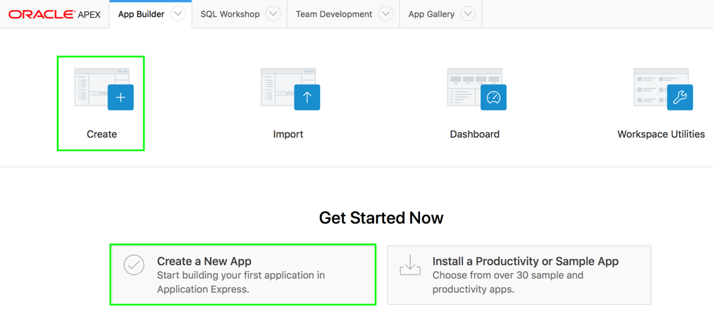
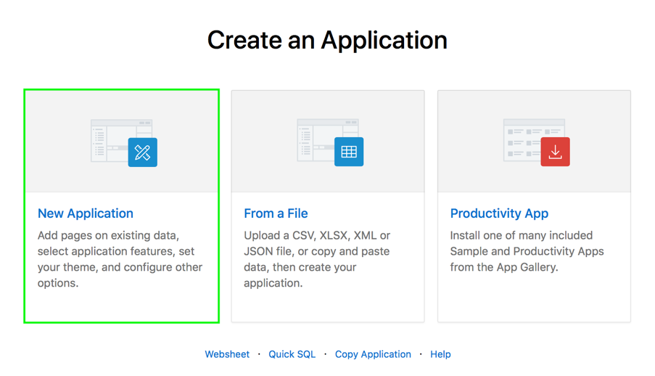
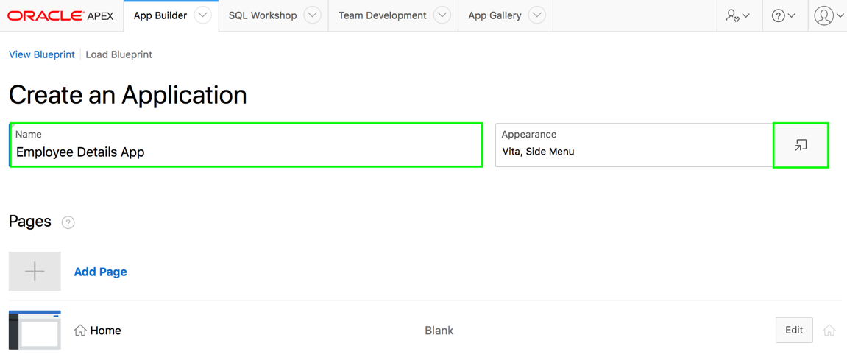
Creating an Application Based on Existing Tables
2
1
3
Notes:
By using the Create Application Wizard, you can create a database application based on existing tables in your Oracle Database. Creating a new database application with the Create Application Wizard is a multiple step process. Once you specify the application name and appearance, you add pages. Database applications can contain multiple pages that include various components such as calendars, cards, charts, dashboards, forms, interactive grids, master detail or editable grids, and reports. Once created, you can edit the page names, alter the page order, and delete them.
On your workspace home page, click App Builder.
Then, perform the following steps:
Click Create.
Click New Application.
The Create an Application page appears. For Name, enter the name used to identify the application to developers. In the slide example, enter Employee Details App for Name. For Appearance, you can accept the default (Vita, Side Menu). If you want to change the appearance, click the Set Appearance icon adjacent to the Appearance field. In the slide example, click the Set Appearance icon.

Slide 10
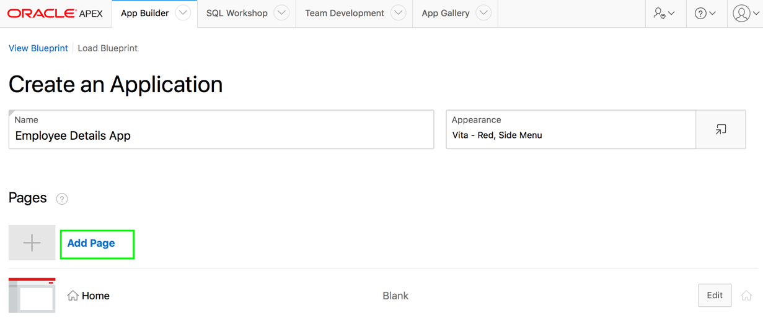
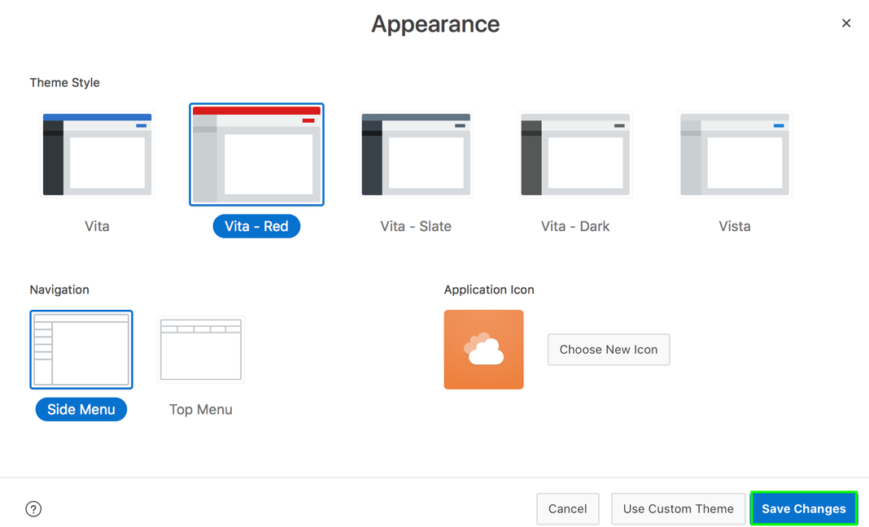
Creating an Application Based on Existing Tables
4
5
Notes:
The Appearance dialog appears. Select the default theme style used to display the application. You can change the style to another pre-defined style, or modify it post generation. In the slide example, select Vita-Red for Theme Style. Select if the menu displays as a Side Menu or Top Menu. In the slide example, accept the default Side Menu.
For Application Icon, click Choose New Icon to change the icon. The Choose Application Icon dialog appears. Your selection displays on the home page of the application. Click Set Application Icon. In the Appearance dialog, click Save Changes.
Now, you add pages to your application. Click Add Page.

Slide 11
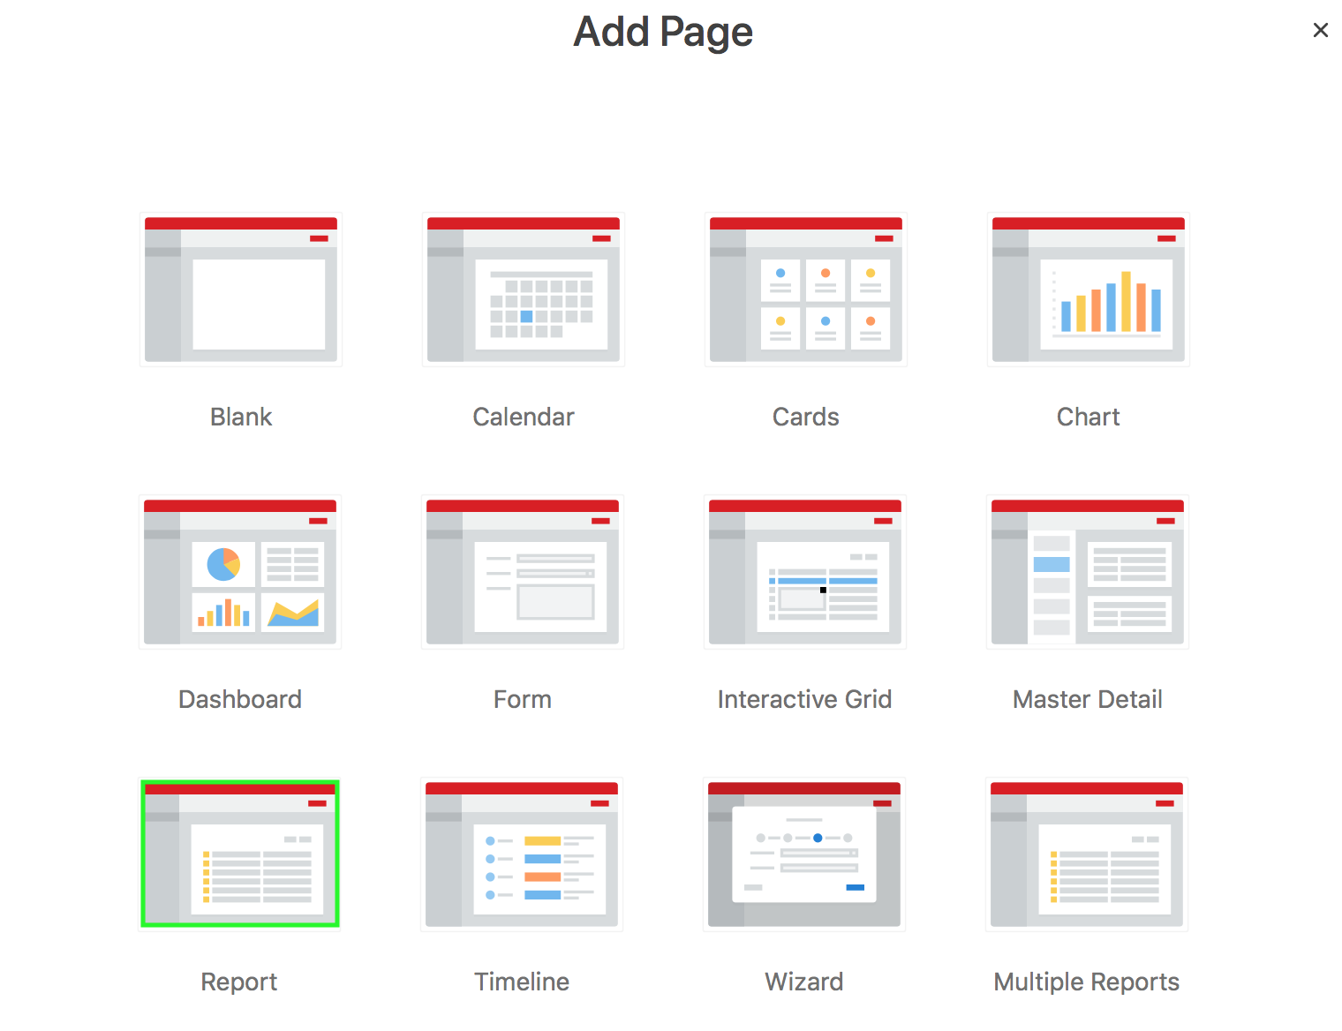
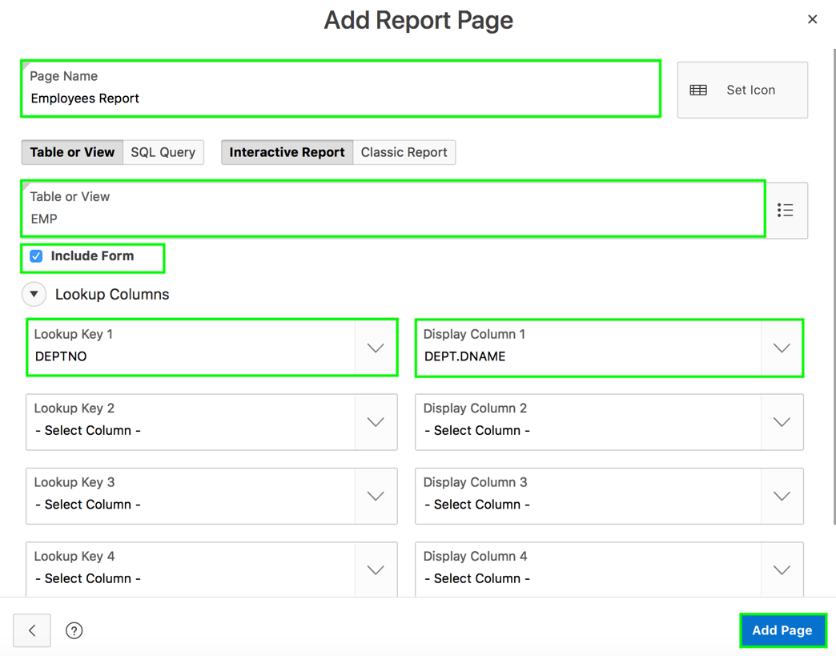
Creating an Application Based on Existing Tables
6
Notes:
The Add Page dialog appears. Select the desired page type. The user interface changes based on the selected page type. Pages you create display under the Home page. After you create an application using the Create Application Wizard, you can modify pages and add additional pages using the Create Page Wizard.
In the slide example, you want to add a Report and Form on the EMP table. Select Report page type and then enter / select the following in the Add Report Page dialog:
Page Name: Employees Report
Table or View: EMP
Include Form checkbox
Lookup Columns > Lookup Key 1: DEPTNO
Lookup Columns > Display Column 1: DEPT:DNAME
Accept the remaining defaults and click Add Page. To add additional pages, repeat this step. You can also just create a blank application without any pages and then later use the Create Page Wizard to add pages as required. You learn more about different page types and how to use the Create Page Wizard later in this course.
In the Create Application wizard, the Home page always displays first and cannot be reordered. You can edit existing pages as follows:
Change the page order. To change the order in which pages appear in your application, click and hold the Drag to reorder page icon and drag and drop it to a new location in the list.
Edit a page. To edit a page click Edit. In the dialog, edit the page name, change the icon, specify if the page is a Home Page or Administration Page, or define Page Help
Delete a page. To delete a page, click Edit and then click Delete .

Slide 12
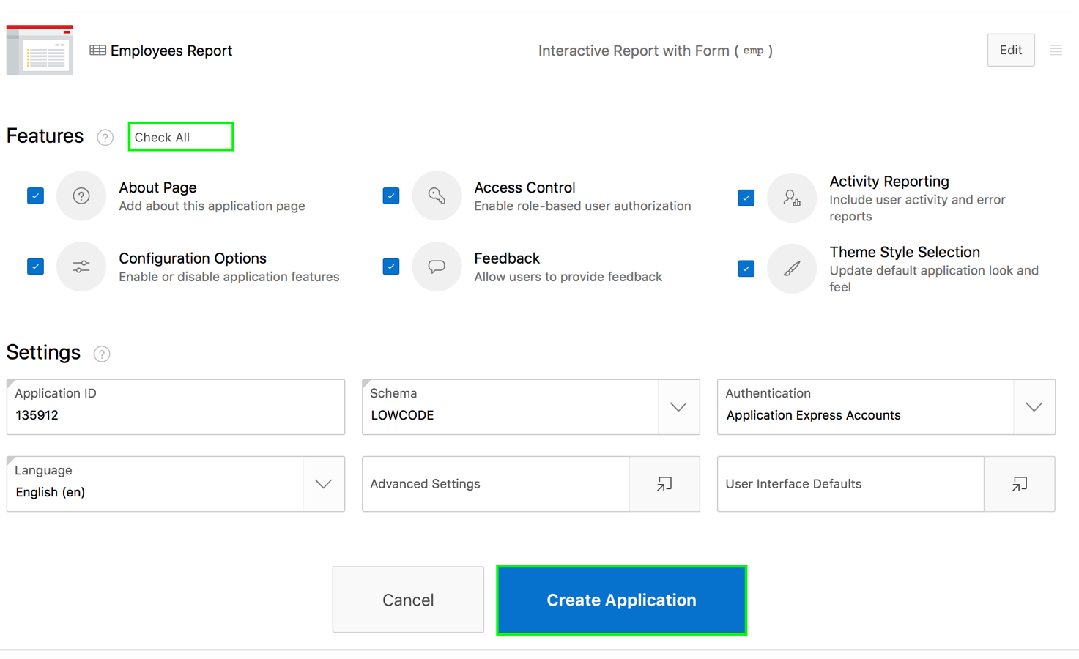
Creating an Application Based on Existing Tables
7
Notes:
For Features, select features to include with your application. Features provide application-level functionality and can only be added once per application. Available features include an Application About page, role-based user authentication, end user activity reports, configuration options to enable or disable specific functionality, a feedback mechanism to gather end users comment, and a Customize button to enable end users to choose their own theme style. In the slide example, you want to include all of the features in your application. Click Check All. Then, you configure Settings. Settings are used in the generation of the application and include the application ID, the database schema, Advanced Settings (such as the application definition, security, and globalization attributes), and application authentication.
For Settings:
Application ID - Enter a unique, numeric identifier for your application. This field contains an automatically generated identifier by default. Application IDs between 3000 to 9000 are reserved for internal use by Oracle Application Express.
Schema - Select the database schema which stores the database objects you want to use in this application. Each application obtains its privileges by parsing all SQL as a specific database schema.
Languages - The primary language used in the app. To change the primary language, click the Select Languages icon.
Authentication - Select how you want users to authenticate into your application..
Advanced Settings - Click the icon adjacent to the Advanced Settings to edit the application definition settings and preferences and security and globalization attributes.
User Interface Defaults - Click the icon to apply User Interface Defaults to this application. In the slide example, you accept the defaults for Settings. Click Create Application.

Slide 13
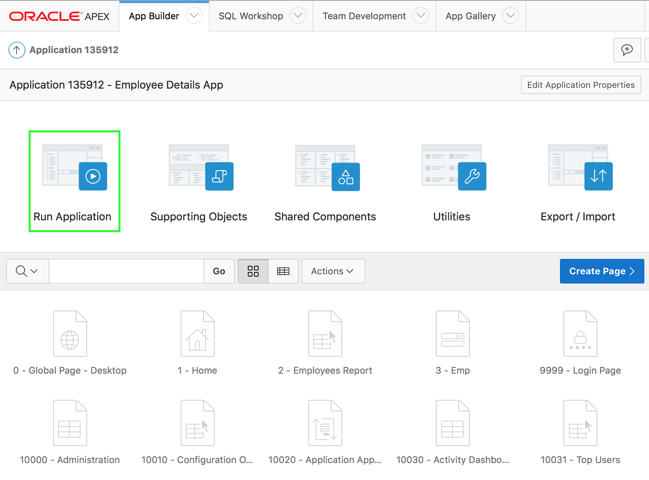
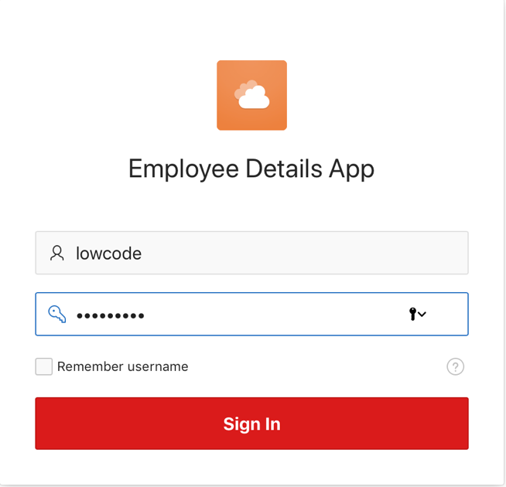
Creating an Application Based on Existing Tables
8
9
Notes:
Now, you see the Application home page. Click Run Application.
In the slide example, you have chosen the Application Express authentication scheme. Therefore, the Login page appears. Enter your workspace username and password, and then click Sign In to log in to your application.

Slide 14
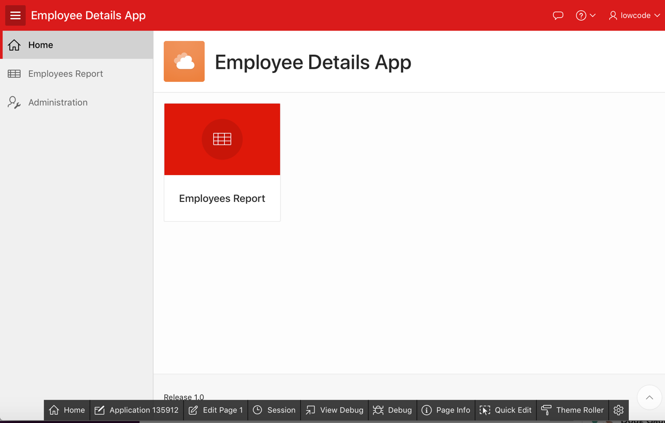
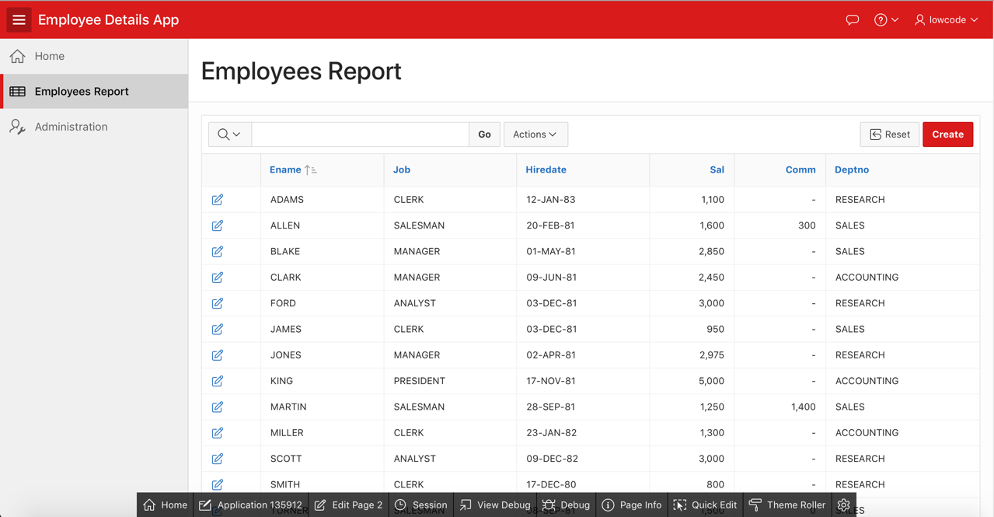
Creating an Application Based on Existing Tables
Notes:
The slide example shows the Employee Details App home page. In the navigation menu, click Employees Report and the interactive report is displayed.

Slide 15
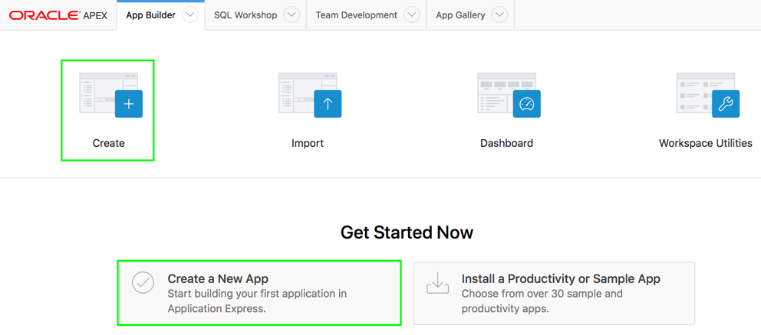
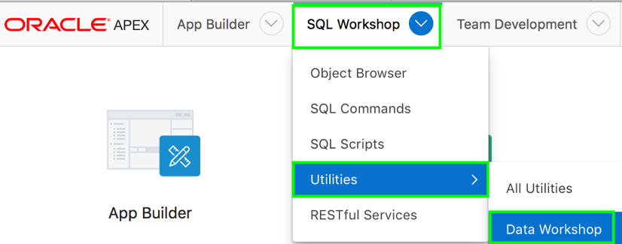
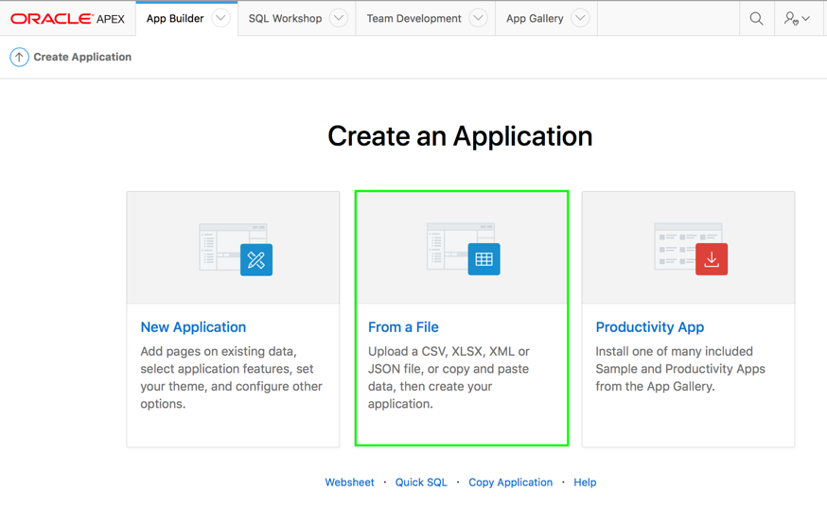
Creating an Application From a File
1
2
On the App Builder home page, click Create.
Click From a File. Or
Navigate to SQL Workshop > Utilities and select Data Workshop.
Notes:
The slide shows the steps involved in creating an app from a file.
Navigate to App Builder and click Create. Note: If this is the first app in your Workspace, you see the Create a New App button under Get Started Now.
Click From a File.
Oracle APEX allows you to upload a CSV, XLSX, XML, TXT, or JSON file and create an application. You can also copy and paste CSV data and then create your application.
You can invoke the Load Data wizard by either of the following two ways:
Navigate to App Builder and perform the following steps:
Click Create.
Click From a File.
Navigate to SQL Workshop > Utilities and then select Data Workshop.

Slide 16
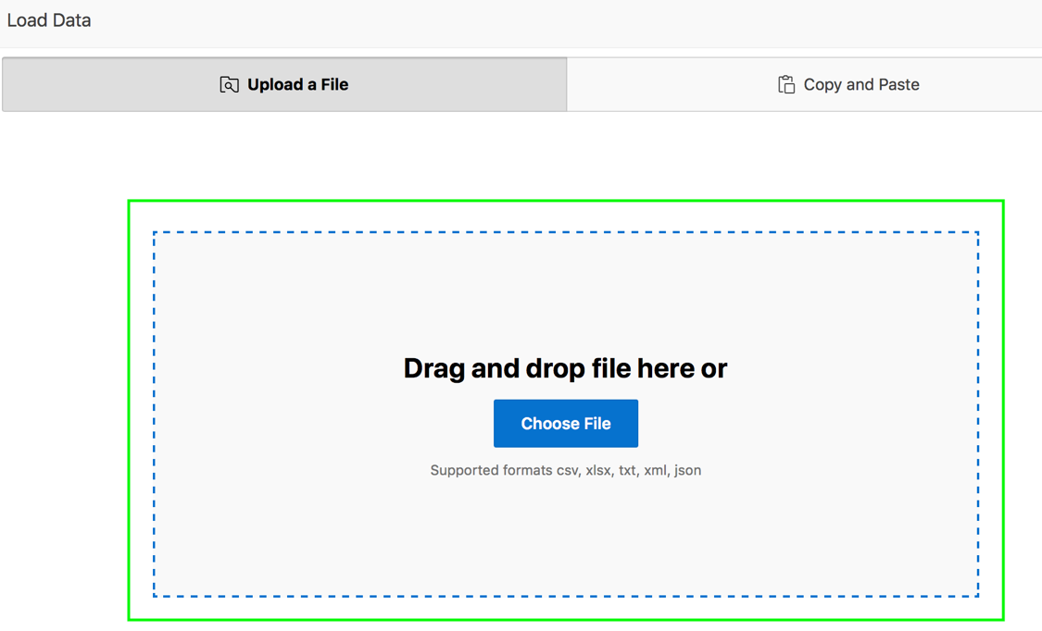
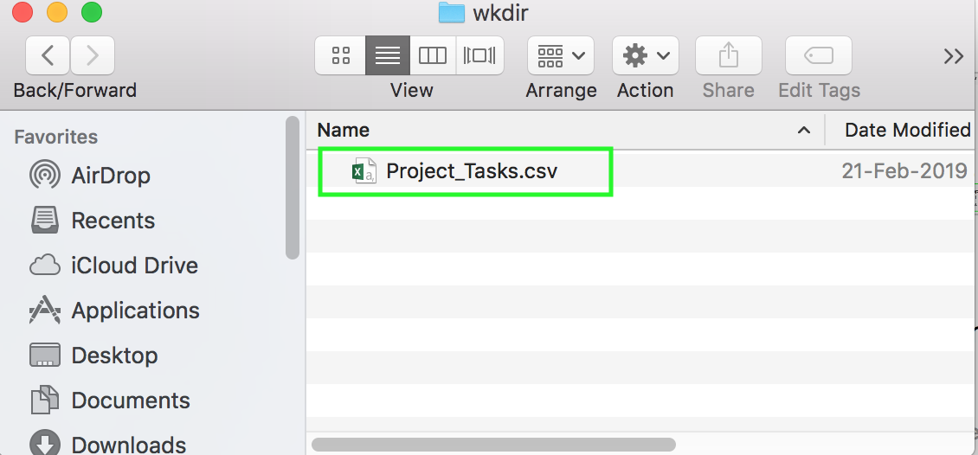
Creating an Application From a File
3
Notes:
The Load Data Wizard appears with the Upload a File tab selected. On the Load Data , you can choose to:
Upload a File. Select this option to load data from a CSV, XLSX, XML, TXT or JSON file.
Copy and Paste. Select this option to copy and paste column delimited data. You have the option of selecting a sample data set from the Select Sample list.
Once you load data into the database table, the wizard provides an option to Continue to the Create Application Wizard. When you continue, a report with form and dashboard pages based on the new table display under Pages. You then finish the application creation process by naming the application.
In the Upload a File tab, you have two options: Drag and Drop - Drag and drop the file to the region in the centre of the page.
Choose File - Click Choose File and then navigate to and select the file.
Navigate to your working directory, select the file you want to load, drag and drop the file to the drop location in the Load Data wizard. In the slide example, select, drag and drop the Project_Tasks.csv file to the Load Data wizard.

Slide 17
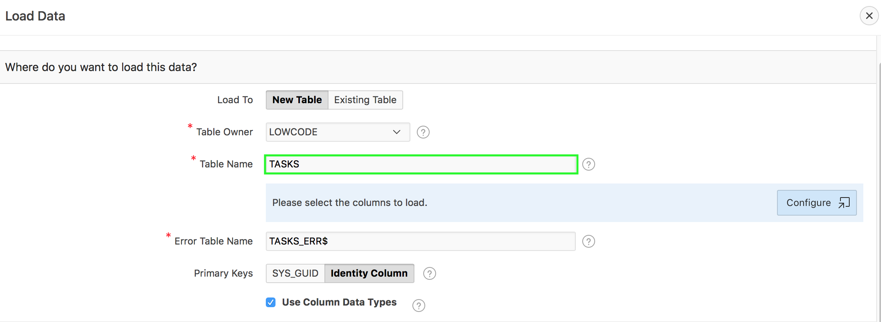
Creating an Application From a File
4
Notes:
The Load Data page appears containing the sections Where do you want to load this data?, Settings, and Preview. Under Where do you want to load this data?, select where to load the data. What appears next depends upon your selection.
Note that the Load Data page that appears differs slightly depending upon the selected file type. You can load data to a new table or an existing table. In the slide example, you load data to a new table. To load data to a new table, select / enter the following:
Load To - Select New Table
Table Owner - Select the database schema you would like to create and load data into.
Table Name - Identify the table name you would like to create. By default, all table names are converted to upper case.
Error Table Name - Identify the error table name you would like to save errors during data load. By default, all table names are converted to upper case. If data load succeeds without any error, this error table is dropped automatically..
Primary Keys - Select how to set the primary key. Options include SYS_GUID or Identity Column (if Oracle Database 12c or later). To learn more, see field-level Help.
Use Column Data Types - Select to use the column types parsed from the file. If un-checked, the table columns will be created as VARCHAR2(4000).
In the slide example, enter Tasks for Table Name and then click in the Error Table Name field. The error table name is populated automatically.
Click Configure.
Under Settings:
Column Headers - Select this option if your data contains column names in the first row.
Separator - Select a column delimiter character (if CSV or TXT file).
Enclosed By - Select a column enclosed by character (if CSV or TXT file). This character eliminates the starting and ending boundary of a data value. If you specify a delimiter character, the wizard ignores white space occurring before the starting and ending boundary of a data value.
File Encoding (if applicable) – Choose the characterset in which the file is encoded.
Preview displays the first 10 coumns and 5 rows. To view the full preview, configure data load settings, and set which columns to load, click the Configure button.
In the slide example, accept the defaults for Settings and click Configure.

Slide 18
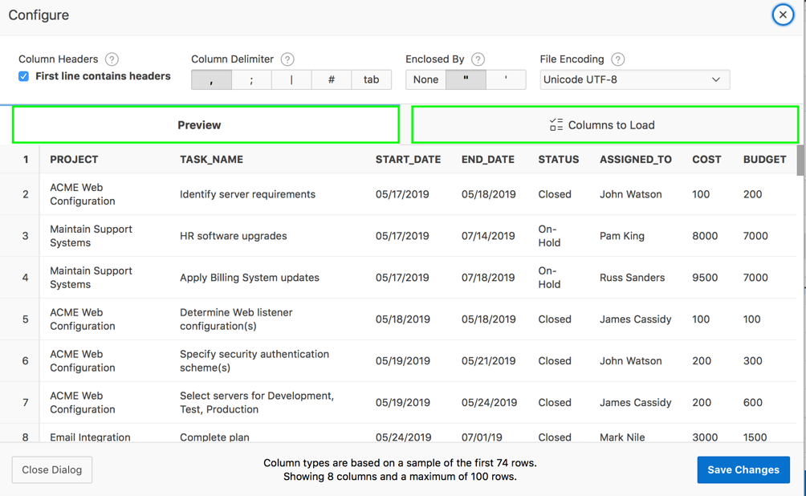
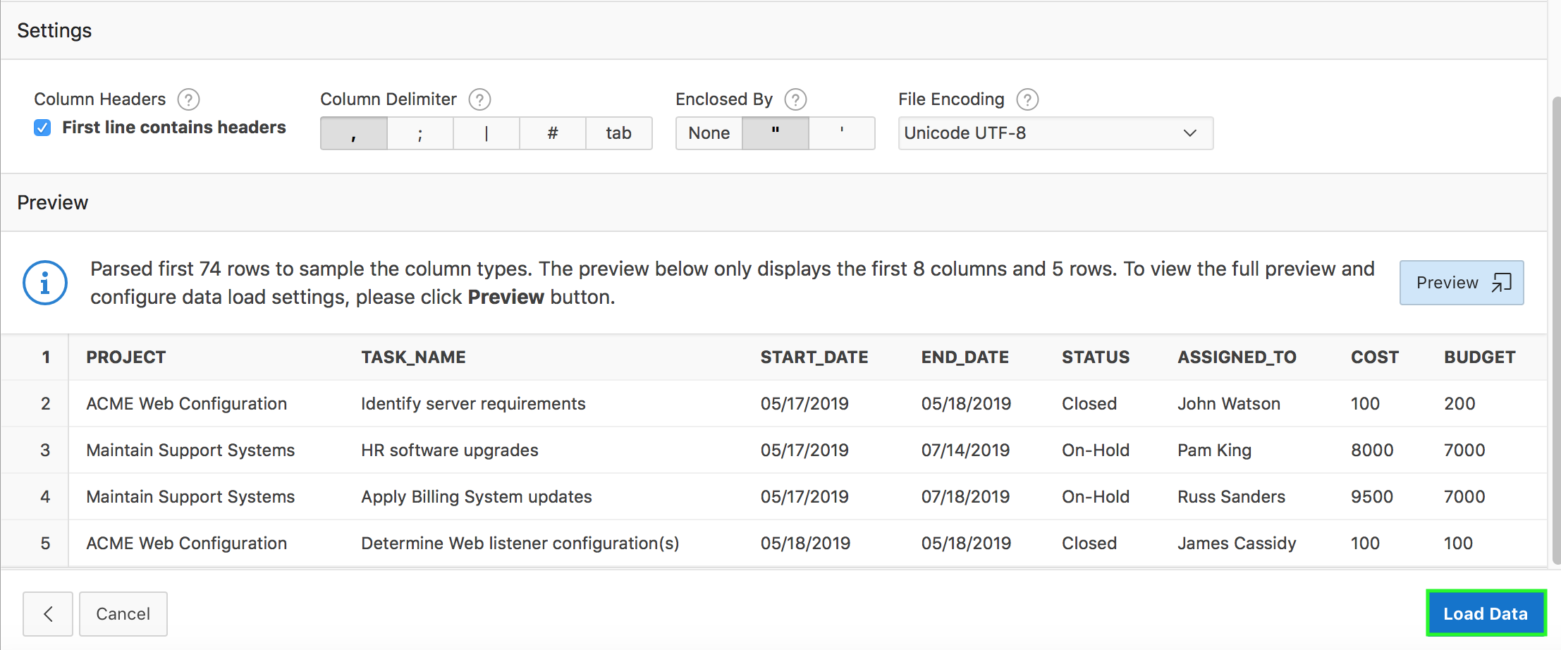
Creating an Application From a File
5
6
Notes:
Two tabs appear: Preview and Columns to Load. To configure the columns to load:
Click Columns to Load.
Rows to Sample - Select the maximum number of rows to be used to sample column types.
Treat as Null - The entered case insensitive value will be treated as NULL. For example, "tbd", "n/a", "unknown", "-".
Columns to Load - Select or deselect the appropriate columns. Column types are automatically detected based on Rows to Sample. For larger data sets, it might make sense to increase the Rows to Sample to get more accurate column types.
Click Save Changes.
In the slide example, you do not configure any columns to load. Click the X to close the Configure dialog.
Click Load Data.

Slide 19
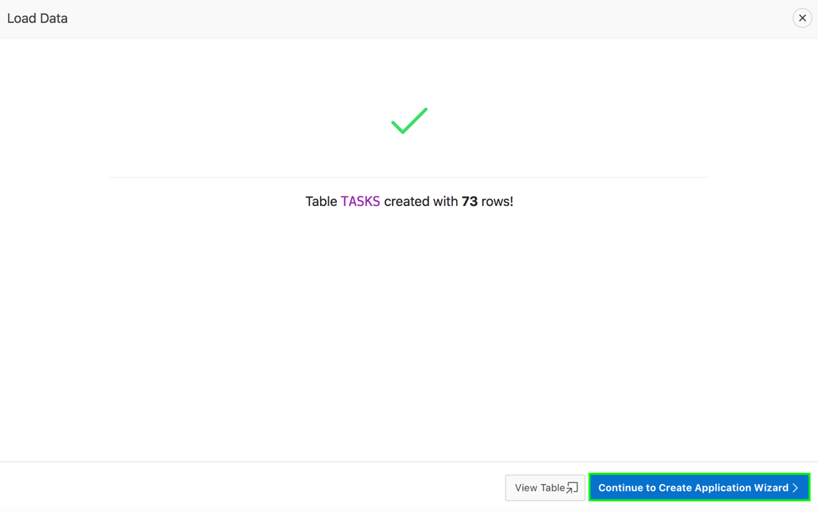
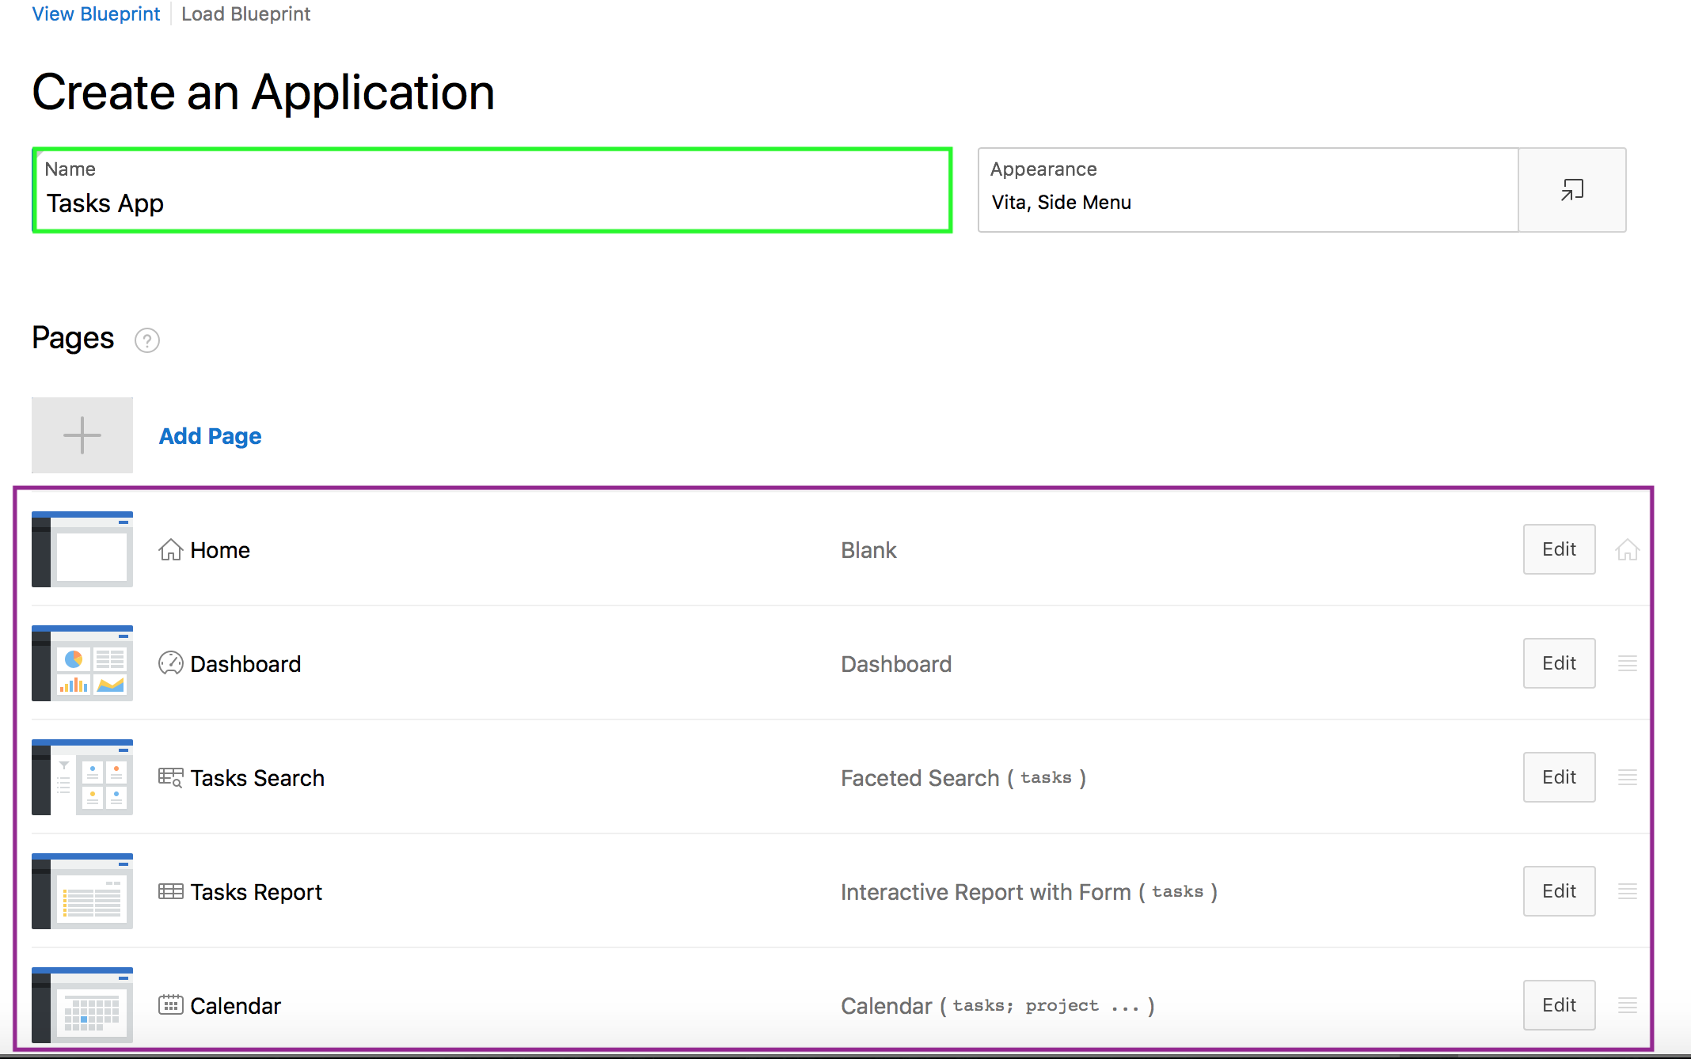
Creating an Application From a File
8
7
Notes:
A confirmation page appears indicating the table and rows have been created. Click Continue to Create Application Wizard.
The Create Application Wizard appears. Home, Dashboard, Faceted Search, Interactive Report with Form, and Calendar pages based on the new table are displayed under Pages. From here, you can edit page name or create additional pages based on the imported data.
For Name, enter the name used to identify the application to developers. In the slide example, you enter Tasks App.
For Appearance, you can either Accept the default (Vita, Side Menu), or change the appearance by clicking the Set Appearance icon and edit the attributes in the Appearance dialog.
To add a page, click Add Page and select the desired page type. The user interface changes based on the selected page type. In the slide example, accept the default for Appearance and Pages.

Slide 20
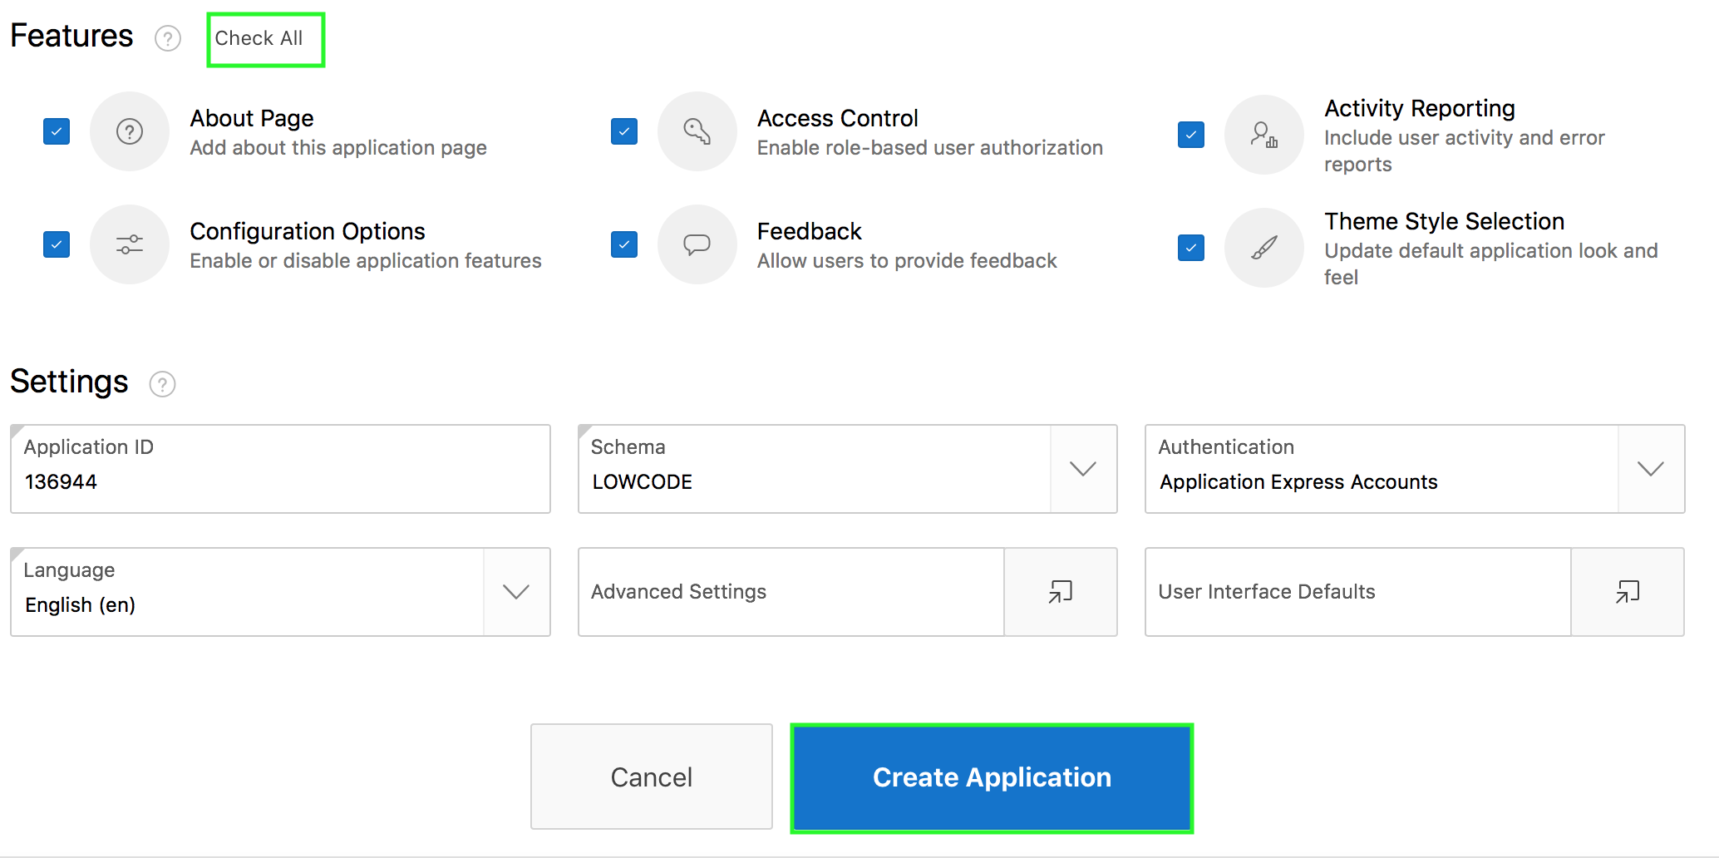
Creating an Application From a File
9
Notes:
For Features, select features to include with your application. In the slide example, click Check All. In the slide example, accept the default for Settings. Click Create Application.

Slide 21
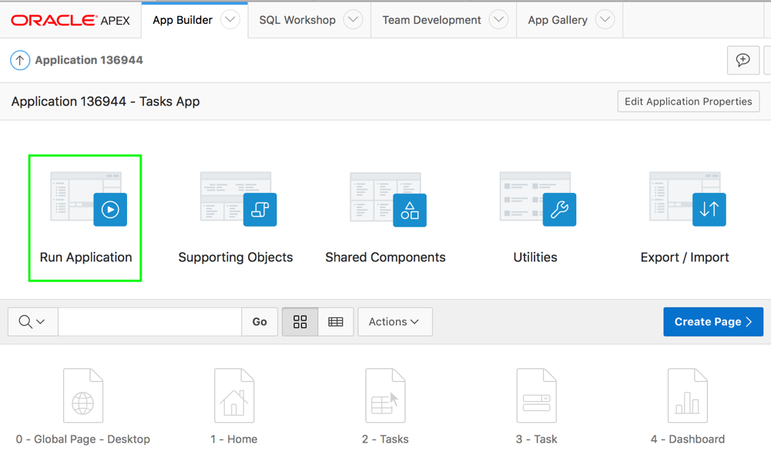
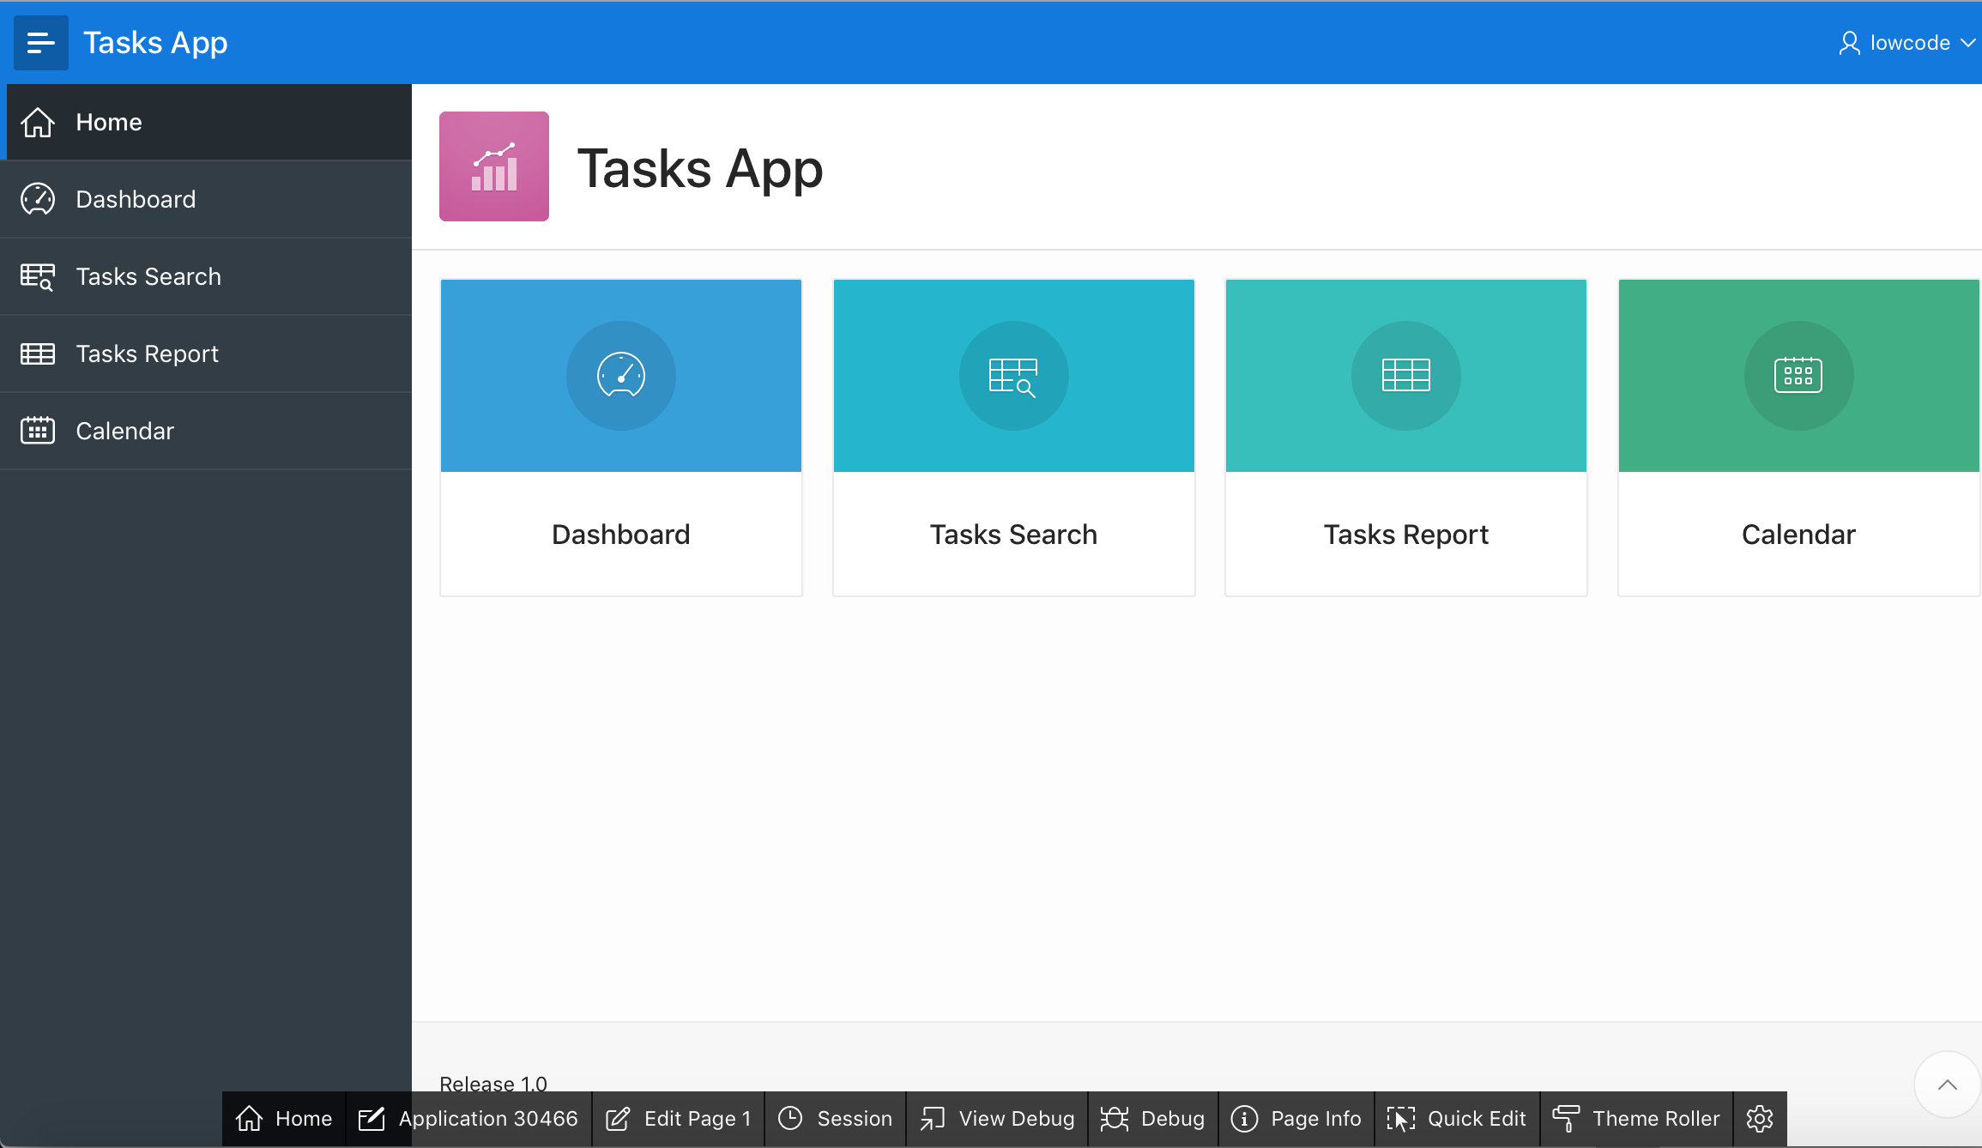
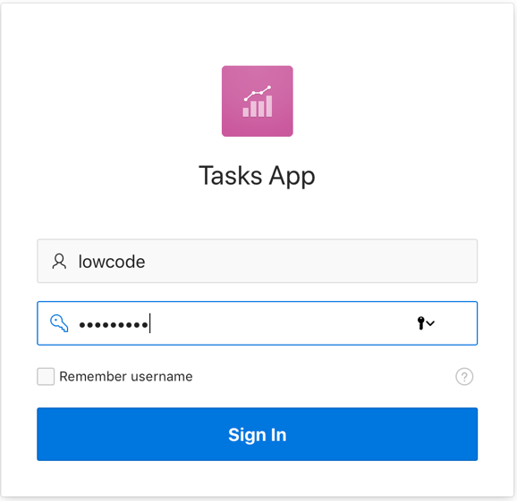
Creating an Application From a File
10
11
Notes:
Your application is now created successfully and you can run the application by clicking the Run Application button on the application home page.
Now, you see the Application home page. Click Run Application.
In the slide example, you have chosen the Application Express authentication scheme. Therefore, the Login page appears. Enter your workspace username and password, and then click Sign In to log in to your application.
The slide shows the Tasks App application home page.
Note: You can navigate to the Object Browser and browse through the tables to review the table that has been created.

Slide 22
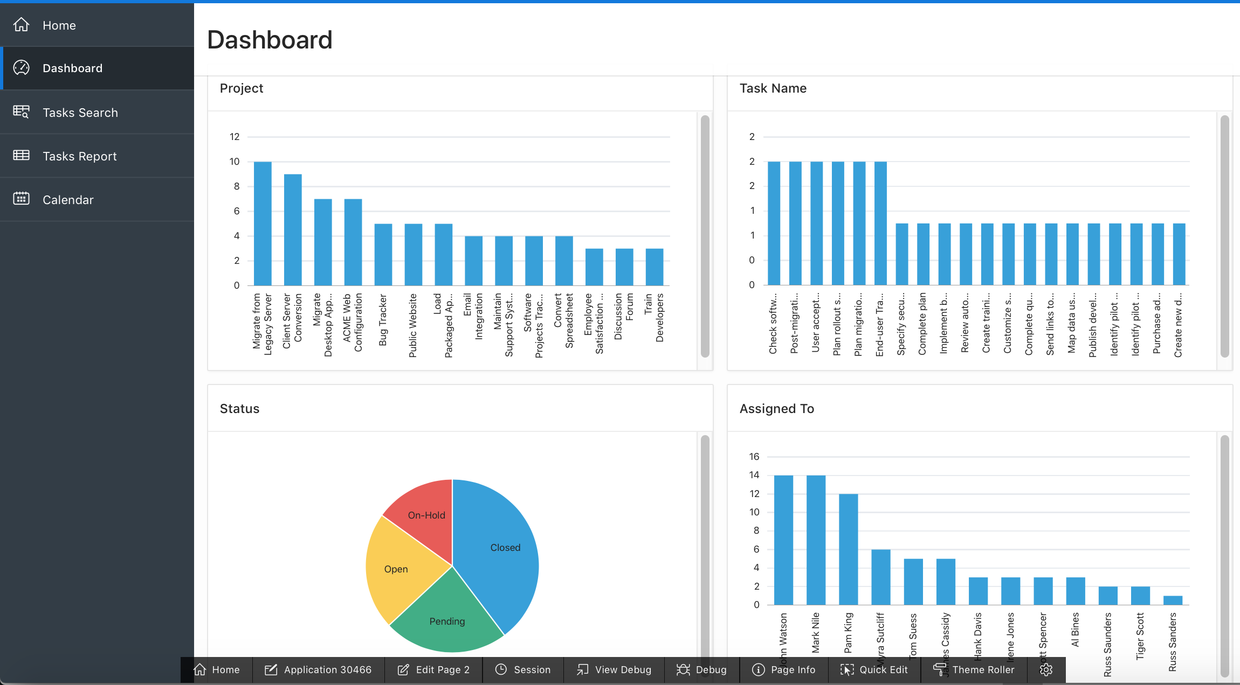
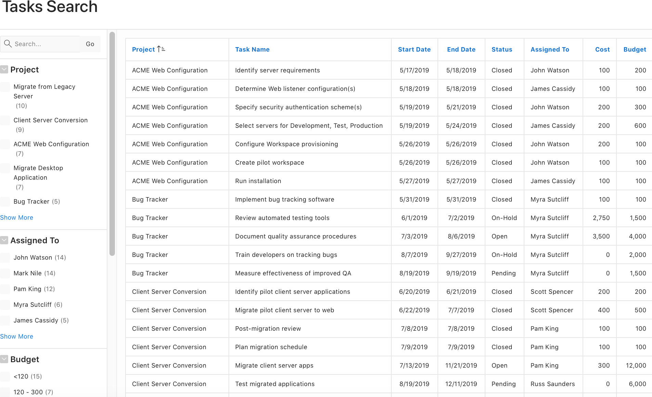
Creating an Application From a File
Notes:
By using the Load Data wizard, your data is loaded in to a single table and an application with a Dashboard, Faceted Search, Interactive Report with Form, and Calendar pages is created. Later, you can expand and include additional functionality into this application.
In the slide example, click Dashboard in the navigation menu. Four different charts are displayed. In the navigation menu, click Tasks Search to view the Faceted Search page. You learn about different types of reports later in this course.

Slide 23
Creating a Mobile Web Application
Mobile apps built with Oracle APEX are browser-based apps that run inside the browser on the mobile device
Build apps for mobile devices with mobile-specific design patterns that can provide an optimal user experience for small screens
Universal Theme is optimized to work on mobile devices and enables you to build modern and responsive web apps
Steps to create a mobile Web app:
Create a new app by running the Create Application Wizard
Run the Create Page Wizard and add the mobile pages
Notes:
Mobile applications developed with Oracle Application Express are browser-based applications that run inside the browser on the mobile device. Therefore, these applications must have a connection in order to communicate with the Oracle Database and cannot operate in a disconnected environment.
Mobile devices that have HTML5 capabilities can utilize all of the capabilities that can be built into the applications, including HTML5 date-pickers, sub-types that display different keypads based on field definition, and so. Older devices will still render the application they will offer less advanced features. The major advantage of developing browser-based applications is that you only need to develop them once for desktop and mobile devices. However, one major limitation is accessing on-device features such as contact lists. This limitation can be alleviated by integrating with solutions such as PhoneGap that support the creation of hybrid solutions, which use a native application wrapper to display the web applications.
Note: Solutions such as Phonegap provide various APIs to access many of the native phone features not currently available using HTML5 or JavaScript.
To learn more, see: http://phonegap.com/
Universal Theme - 42 (Universal Theme) enables developers to build modern web applications without requiring extensive knowledge of HTML, CSS, or JavaScript. Universal Theme is a responsive, versatile, and customizable user interface for your Application Express apps. It is designed uniquely for Oracle APEX to make it easy for developers to build beautiful, modern applications, at any scale, for any purpose, that work on any device. You learn more about Universal Theme later in this course.
To create a mobile application:
Create a new application by running the Create Application Wizard.
Run the Create Page Wizard and add mobile pages.
You learn more about the Create Page Wizard later in this course.

Slide 24
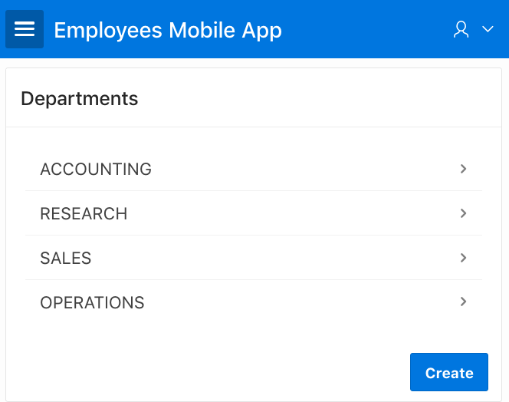
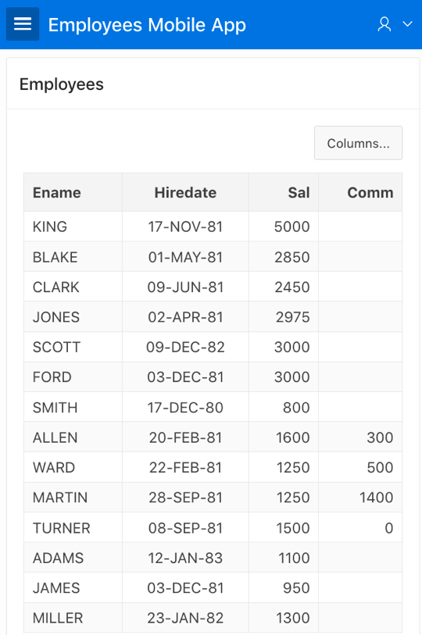
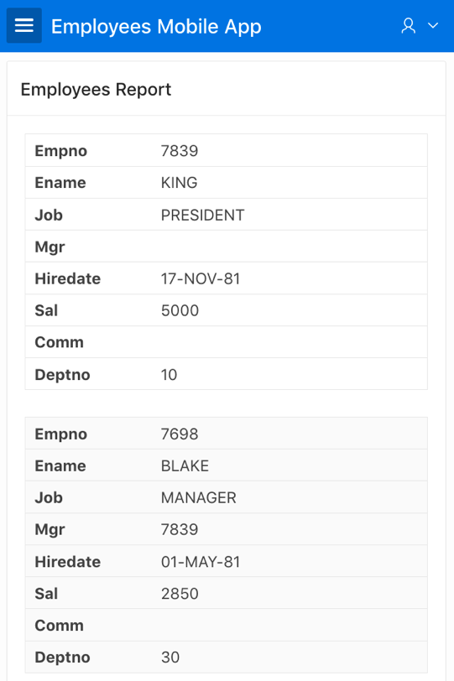
Creating a Mobile Web Application: Report Types
List View
Column Toggle Report
Reflow Report
Notes:
The slide example shows three different types of reports that you can create for mobile devices.
Although the Universal Theme is optimized to work well on mobile devices, not all components are mobile friendly. For example, interactive reports and interactive grids do not work well in mobile environments. When creating reports for mobile devices, Oracle recommends the following report types:
List View
Features a responsive design to display data and provide easy navigation on Smartphones. Creates a page that contains the formatted result of a SQL query. You choose a table on which to build the List view and select a database column to be used for the List view entry.
Column Toggle Report
Creates a responsive report designed for mobile applications and Smartphones. By default, column toggle reports are created with all columns set to the same priority. However, the developer can edit the report column attributes and rank columns by importance. Columns with a lesser priority (larger number) are hidden at narrower screen widths. The report includes a Columns button which enables end users to select which columns they want to view.
Reflow Report
Creates a responsive report designed for mobile applications and Smartphones. When there is not enough space available to display the report horizontally, the report responds by collapsing the table columns into a vertical value pairs layout where each column displays on a separate row.
You learn more about the interactive report, interactive grid, and other report types later in this course.

Slide 25
Summary
In this lesson, you learned how to:
Create a database web application based on existing tables
Create a database web application from a file
Convert a spreadsheet in to a database web application
Create a mobile web application
Notes:
In this lesson, you learned how to use the App Builder to create database web applications that can be run on any device. You learned how to use the Create Application Wizard to build a database web application based on existing tables. This lesson also covered how to convert a spreadsheet in to a fully functional database application. You reviewed the steps involved in creating a mobile Web application and also the type of reports you can build for your mobile devices.

Slide 26


Slide 27
Hands-on Lab

